Slide 1
Identification of Business Opportunities
Notes:
1

Slide 3



Slide 4



Slide 5


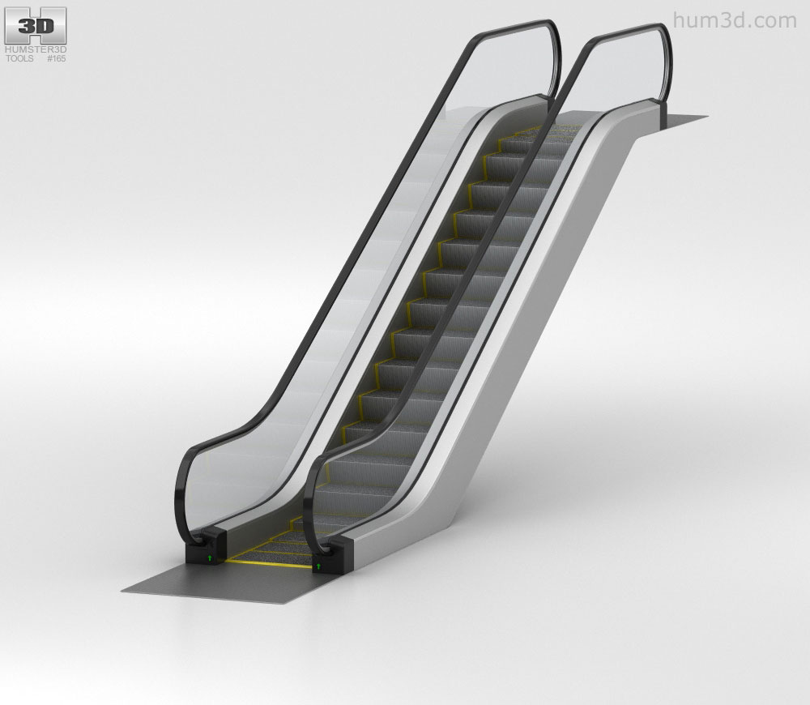

Slide 7
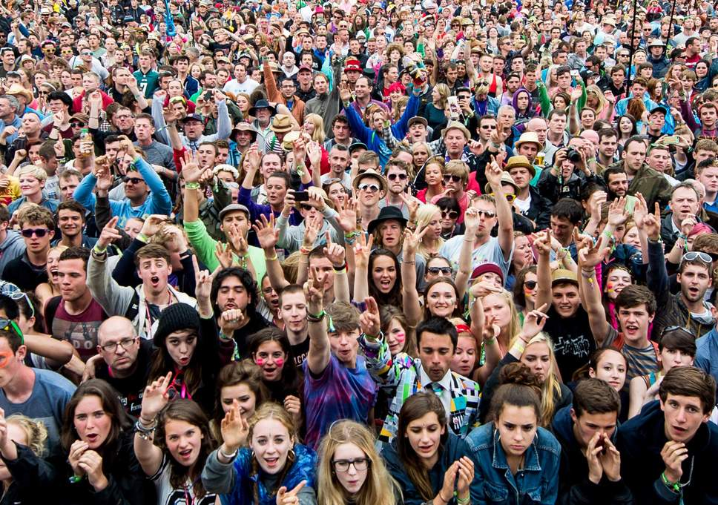





Slide 8
Business Idea and Business Opportunity
A business idea, is a concept that can be used for a commercial purpose, typically involves the introduction of new products and services into new markets.
A Business opportunity is a situation in which a person can exploit a new business idea that has the potential to generate profit.

Slide 9
What Is an Entrepreneurial Opportunity ?
They create or add significant value to the customer.
They solve a significant problem by removing pain points or meeting a significant want or need for which someone is willing to pay a premium.
They have a robust market, margin, and money making characteristics that will allow the entrepreneur to estimate and communicate sustainable value to potential stakeholders.
They are a good fit with the founder(s) and management teams at the time and market place along with an attractive risk-reward balance.
Notes:
9

Slide 10
What defines a good business opportunity?
A resolved problem (to find a solution) faced by an actual or potential entrepreneur.
An unmet customer need discovered by an actual or potential entrepreneur at a place of employment.
Changes in the business environment
Notes:
10

Slide 11
Characteristics of Business Opportunity
Urgency of the market need
Adequate market size – Demographic, Geographical, Lifestyle Factor.
Sound business model – Purpose, Strategies, infrastructure, Organizational Structure, Marketing Program, operation policy and procedure.
Potential brand value - to maintain a competitive advantage in the market.
An able management team - to make it worthwhile and the team should be looking forward to being involved with it for a long time.
Notes:
11

Slide 12
When Is an Idea an Opportunity?
A business opportunity is a business idea that has been researched upon, refined and packaged into a promising venture that is ready to launch.
5 essential qualities are required:-
Attractiveness
Timeliness
Durability
Relevant (Must fulfil customer needs or solve the problem)
Creative and innovative
Notes:
12

Slide 13
Methods for Generating New Business Ideas

Slide 14



Slide 15
Brainstorming
8–12 people and should be performed in a relaxed environment.
Encouraged to share every idea that enters their mind with the assurance that there is no right or wrong answer.
Setting the time limit (such as, say, 30 minutes) for the session.
The facilitator clearly sets down the rules, discouraging criticism of any kind and encouraging a freewheeling approach, the voicing of as many ideas as possible, and a collective and constructive effort towards the improvement of ideas.
The facilitator writes each idea down for everyone to see.
Once time is up, the best ideas are selected, based on a few criteria decided upon in advance (such as, say, cost-effectiveness).
The selection must be made on the basis of a consensus from everyone in the group.
A score (say, zero to ten points) is given to each idea depending on how well it meets the criteria.
Notes:
15

Slide 16
Survey Method
The survey method involves gathering information from a representative sample population, that is, a fraction of the whole population under study that presents an accurate proportional representation of that population.
Surveys generate new products, services, and business ideas because they ask specific questions and get specific answers.
For example, Hindustan Unilever Limited undertook a market survey to explore the possibility of penetrating rural markets in India, and this helped the market research team to identify the idea of introducing shampoo sachets, which became an instant hit with people who would not buy an entire bottle of shampoo.
Surveys may be of different types, such as general and specific surveys, regular and ad hoc surveys, preliminary and final surveys, and census and sample surveys.

Slide 17
Reverse Brainstorming - with the exception that criticism is allowed.
The focus is on the negative aspects of every idea that has been generated through brainstorming.
Also called the “sifting” process, this process most often involves the identification of everything that is wrong with an idea, followed by a discussion of ways to overcome these problems.
Gordon method - Collective discussion addresses every aspect of the planned product in an uninhibited solution-oriented way.
For example, to devise a new pen-holder, the group discusses the “holding” theme and examines all possible meanings of this word and all possible examples of “holding” (such as items, nature, etc.).
The group will later sit and study each idea to see if any of them may be useful for the planning of a new pen-holder. This discussion encourages a fresh, creative, and unusual approach to developing a new product.

Slide 18
Entrepreneurial Opportunity
What leads to the creation of opportunities?

Slide 19
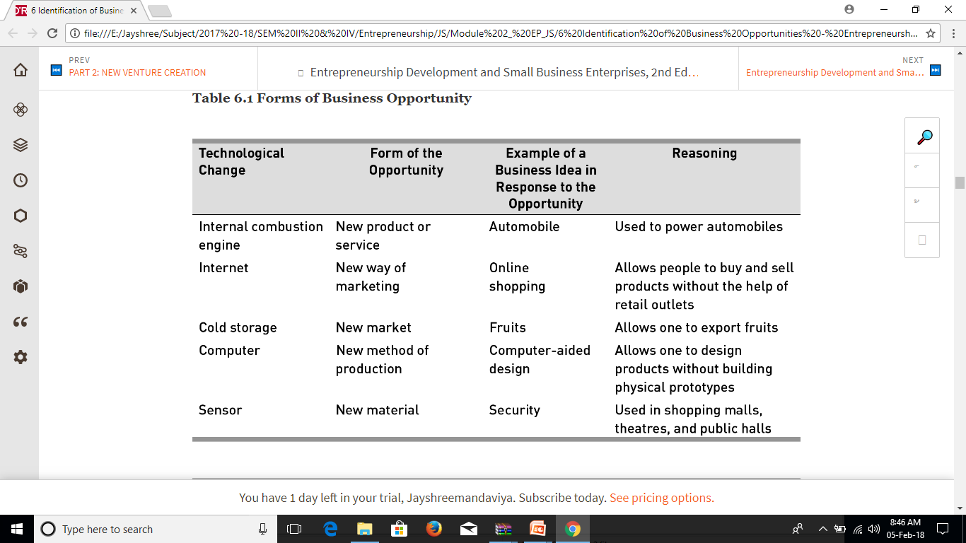
Technological change

Slide 20
Entrepreneurial Opportunity– External Change
Regulatory and political change –
The use of helmets was made compulsory by the government, helmets were reintroduced into the market with new features and the demand for helmets improved substantially.
Political support for the country’s infrastructural development, such as in the case of the construction of the golden quadrilateral, led to many business opportunities in the construction sector.
To help companies comply with the ISO 9000 quality management system, the ISO 14000 environmental management system and the sarbanes–oxley act of 2002.

Slide 21
Entrepreneurial Opportunity – External Change
Social and demographic change
Changes in Family and Work Patterns, the ageing of the population, increasing diversity at the workplace, increasing focus on health and fitness, the increase in the number of cell phone and Internet users, and new forms of entertainment, lead to the creation of business opportunities because they alter people’s preferences or demand for products and services, and consequently make it possible to generate new ideas to meet new demands.
For example, the ageing of the Indian population over the last 25 years generated business opportunities for entrepreneurs to make products and services for the elderly.

Slide 22
Entrepreneurial Opportunity – External Change
Economic Change
Changes Economic forces affect business opportunities by determining who has money to spend.
An increase in the number of women in the workforce over the last few decades and their related increase in disposable income is largely responsible for the number of boutique clothing stores targeting professional women that have opened in the past few years.

Slide 23
How to Identify a Business Opportunity?
Observing trends
To follow economic, social, technological, and political trends.
For example, the development of the internet and the miniaturization of electronics goods led to the development of e-commerce and laptop computers, respectively.
Solving a problem
To recognize and solve a pressing problem that customers are facing today.
For example, one of the most pressing problems facing countries round the globe is finding alternatives for fossil fuels. As a result, a number of entrepreneurial firms have been (and are still being) launched to take on this challenge.
Notes:
23

Slide 24
How to Identify a Business Opportunity?
Finding gaps in the market place
Identifying business opportunities is to find a gap between what is needed by the customer and what is actually provided to the customer.
For example, over three decades ago, the lack of toy stores focusing on a child’s intellectual development resulted in the development of Discovery Toys, a California-based company specializing in educational toys.

